Slide 1
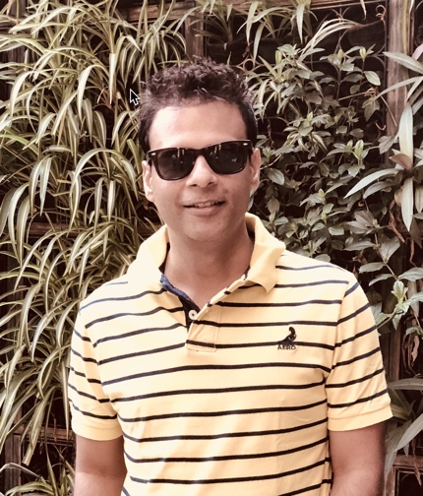
Storage and Backup Engineer Architect
Senior Storage & Backup Implementation Specialist with 21 years of total IT experience. Major part of his Career worked with Fusionstorm/Computacenter
SME on EMC/Dell Backup & Disaster Recovery Solution’s In early from 2010 worked on Avamar and Storage implementation in NEW YORK area
I also got an opportunity at SunGard to Play a Lead Technical Architect role in Cloud Product Development Team where I Designed EMC VNX Storage (BLOCK & FILE), and Recover Point Multitenancy target)

Slide 2
Roles and Responsibility
Day-to-day operation management of backup\storage in key accounts
Escalation point for any backup and storage related queries
Help team members with formulating, managing and executing Installation\(re)Configuration tasks and help improve operational efficiency
Lead engineer responsible for proper executions in few key accounts

Slide 3
My Driving Force
Driving force - Technology
Reason – I started Carrear at Helpdesk Engineer, and in my journey technology has played a vital role , Windows Unix EMC Storage ,Stuck with EMC storage for quite some time , Fusionstorm gave opportunity to work all flavours of technology . Vmware Backup Cisco .

Slide 4
Your thoughts on opportunities and challenges.
I consider all Challanges are opportunity , there is never .
Standard Charter – some XYZ switch migration story .

Slide 5
What personal investments did you make in the last 12 months, and how did they impact you and the business? Last 12 months Achievements
I had been taking care of some key Accounts
I added more key accounts to my profile Roblox Fanduel
Impact – MLB take care by Texas team

Slide 6
Top professional accomplishment in the last 12 months?
Succesful happy customer
MLB Contract renewal
Brixmor Contract Renewal
Roblox Contract Renwal

Slide 7
What value did you bring to the business over the last 12 months?

Slide 8
What worked well, what didn’t work well, what would you do differently, and how do you think this would alter the outcome?

Slide 9
What investments do you plan to make in the next 12 months, why, and what do you hope to achieve?
New Cusotomer onboard
Parallel training

Slide 10
Anything else you want to share.

